Slide 1
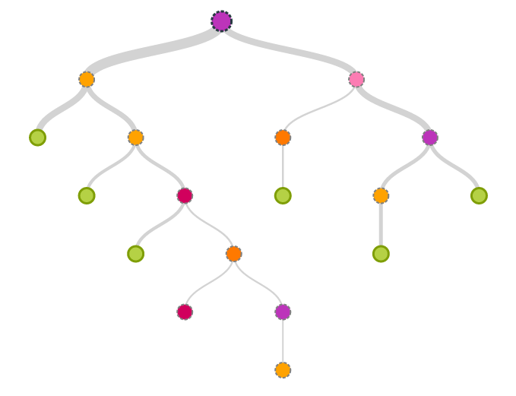
Decision Tree R Exercise:
Regression Tree
Pilsung Kang
School of Industrial Management Engineering
Korea University

Slide 2
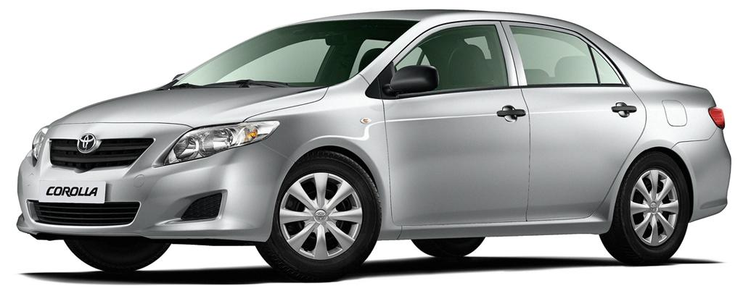
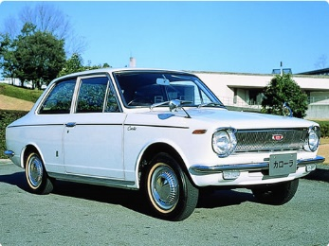
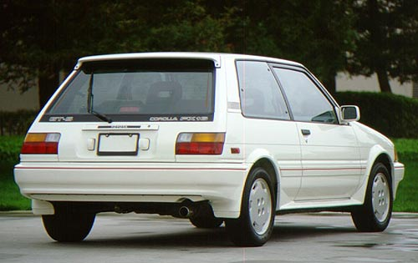
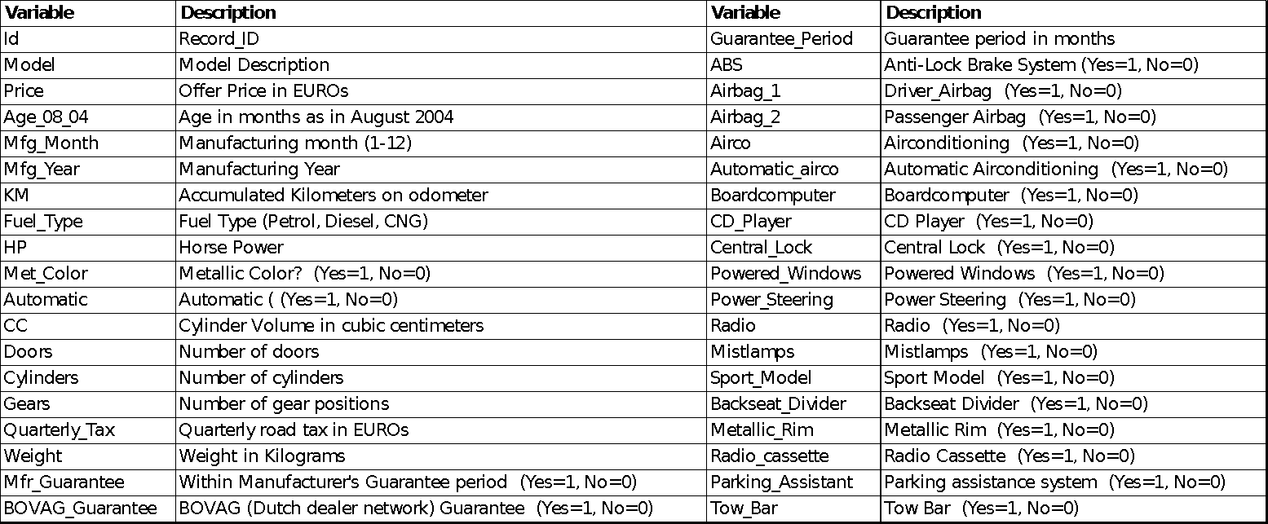
R Exercise: Regression Tree
Data Set: Toyota Corolla Selling Price

Slide 3
R Exercise: Regression Tree
Define the performance evaluation function
perf_eval_reg( ) function
Arguments: target values & predicted values
Outputs: RMSE, MAE, MAPE
# Performance evaluation function for regression -------------------------- perf_eval_reg <- function(tgt_y, pre_y){
# RMSE
rmse <- sqrt(mean((tgt_y - pre_y)^2))
# MAE
mae <- mean(abs(tgt_y - pre_y))
# MAPE
mape <- 100*mean(abs((tgt_y - pre_y)/tgt_y))
return(c(rmse, mae, mape))
}
# Performance table initialization
Perf_table <- matrix(0, nrow = 2, ncol = 3)
colnames(Perf_table)<- c("RMSE", "MAE", 'MAPE’)
rownames(Perf_table)<- c("MLR", "Regression Tree")
Perf_table

Slide 4
R Exercise: Regression Tree
Load the dataset and Convert “Fule_Type” variable to three dummy variables
# Load the dataset
corolla <- read.csv("ToyotaCorolla.csv")
# Regression model 1: multivariate linear regression (MLR)
id_idx <- c(1,2)
category_idx <- 8
# Transform a categorical variable into a set of binary variables
dummy_p <- rep(0,nrow(corolla))
dummy_d <- rep(0,nrow(corolla))
dummy_c <- rep(0,nrow(corolla))
p_idx <- which(corolla$Fuel_Type == "Petrol")
d_idx <- which(corolla$Fuel_Type == "Diesel")
c_idx <- which(corolla$Fuel_Type == "CNG")
dummy_p[p_idx] <- 1
dummy_d[d_idx] <- 1
dummy_c[c_idx] <- 1
Fuel <- data.frame(dummy_p, dummy_d, dummy_c)
names(Fuel) <- c("Petrol","Diesel","CNG")
# Prepare the data for MLR
corolla_mlr_data <- cbind(corolla[,-c(id_idx, category_idx)], Fuel)

Slide 5
R Exercise: Regression Tree
Train an MLR model and evaluate it with the test dataset
# Split the data into the training/validation sets
set.seed(12345)
trn_idx <- sample(1:nrow(corolla), round(0.7*nrow(corolla)))
MLR_trn <- corolla_mlr_data[trn_idx,]
MLR_tst <- corolla_mlr_data[-trn_idx,]
# Train the MLR
MLR_corolla <- lm(Price ~ ., data = MLR_trn)
MLR_corolla
# Performance Measure
MLR_corolla_haty <- predict(MLR_corolla, newdata = MLR_tst)
Perf_table[1,] <- perf_eval_reg(MLR_tst$Price, MLR_corolla_haty)
Perf_table
 | RMSE | MAE | MAPE
MLR | 1244.73 | 882.77 | 8.92
Regression Tree

Slide 6
R Exercise: Regression Tree
Install the necessary package, divide the dataset, and train the full tree
(Note) Variable <Fuel_type> is not converted to dummy variables
Decision tree can handle both numeric and categorical variables
Use the same function tree to train the regression tree
Target variable <Price> is numeric 🡪 Regression tree is constructed
# Regression model 2: Regression Tree
# Install the necessary package
install.packages("tree")
library(tree)
corolla_rt_data <- corolla[,-id_idx]
RT_trn <- corolla_rt_data[trn_idx,]
RT_tst <- corolla_rt_data[-trn_idx,]
# Training the tree
RT_corolla <- tree(Price ~ ., RT_trn)
summary(RT_corolla)

Slide 7
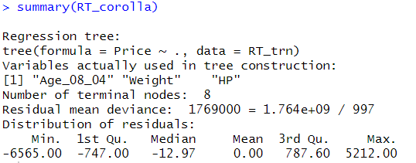
R Exercise: Regression Tree
Check the result
Only tree variables (Age_08_04, Weight, HP) are used to construct the regression tree
The number of leaf (terminal) node is 8

Slide 8
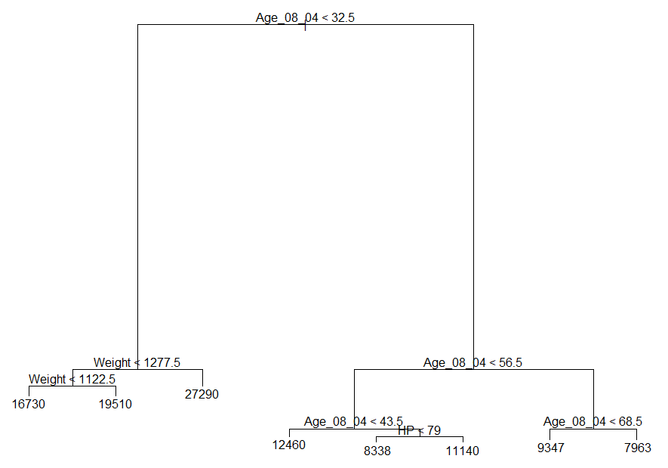
R Exercise: Regression Tree
Check the result
# Plot the tree
plot(RT_corolla)
text(RT_corolla, pretty = 1)

Slide 9
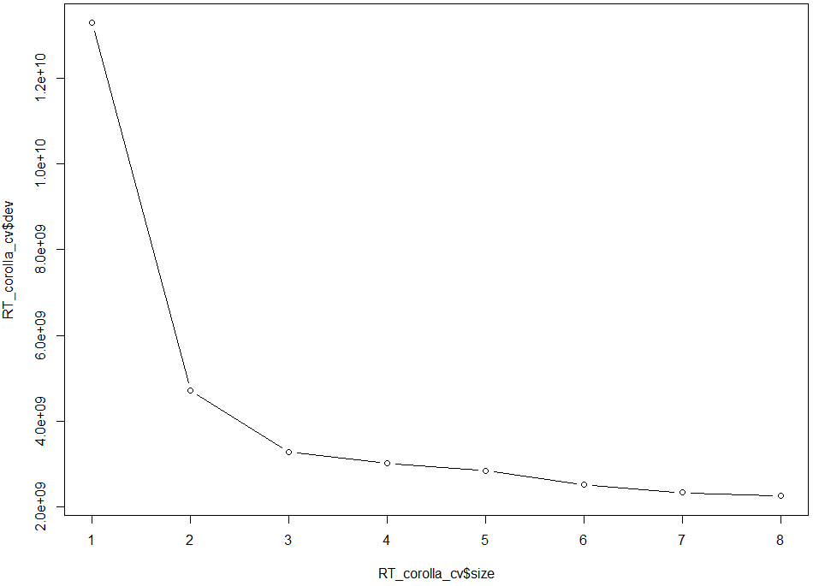
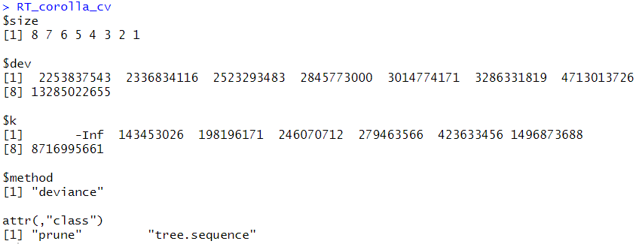
R Exercise: Regression Tree
Prune the tree based on 10-fold cross-validation
# Find the best tree
set.seed(12345)
RT_corolla_cv <- cv.tree(RT_corolla, FUN = prune.tree)
# Plot the pruning result
plot(RT_corolla_cv$size, RT_corolla_cv$dev, type = "b")
RT_corolla_cv

Slide 10
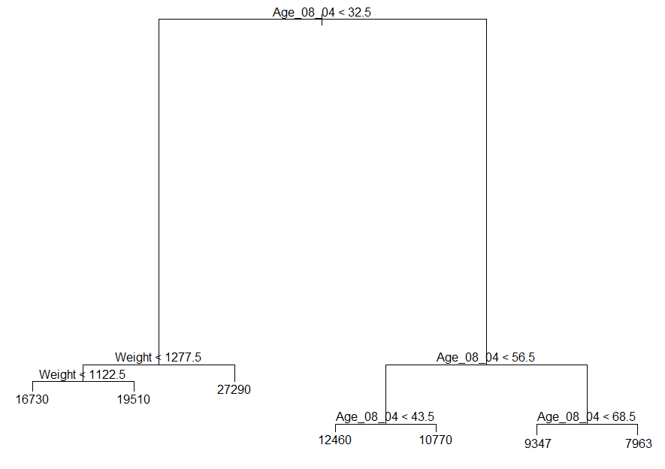
R Exercise: Regression Tree
Prune the tree based on 10-fold cross-validation
# Select the final model
RT_corolla_pruned <- prune.tree(RT_corolla, best = 7)
plot(RT_corolla_pruned)
text(RT_corolla_pruned, pretty = 1)
Before pruning
After pruning

Slide 11

R Exercise: Regression Tree
Make prediction for the test dataset and evaluate the performance
# Prediction
RT_corolla_prey <- predict(RT_corolla_pruned, RT_tst, type = "vector")
# Compare the regression performance
Perf_table[2,] <- perf_eval_reg(RT_tst$Price, RT_corolla_prey)
Perf_table
 | RMSE | MAE | MAPE
MLR | 1244.73 | 882.77 | 8.92
Regression Tree | 1416.66 | 1023.72 | 10.18

Slide 12


